Slide 1
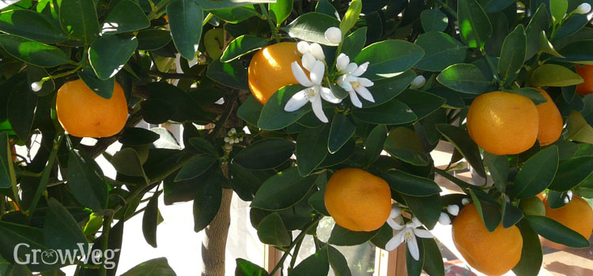
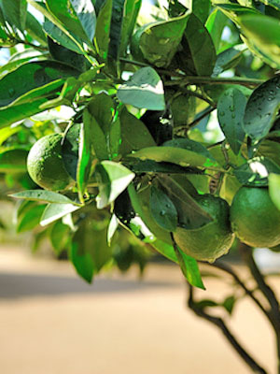
Yes! You can grow Citrus in Wisconsin!
Notes:
I’ve had a lemon tree for almost 10 years. My daughter brough one home from the potting shed when she lived with us for a year. ‘ve gotten many lemons off of it and honestly didn’t know much about growing them.
A c ouple years ago during the pandemic I ended up in the Emergency room with blood pressure through the roof. I decided I needed to do something calm and boring and started reading about growing citrus. It brought my blood pressure down quite nicely.
I believe that when we teach others that is when we really learn about something. I found out I’ve done many things wrong. So the good news is that Citrus are quite forgiving of our ignorance..
Lets look at what it takes.

Slide 2
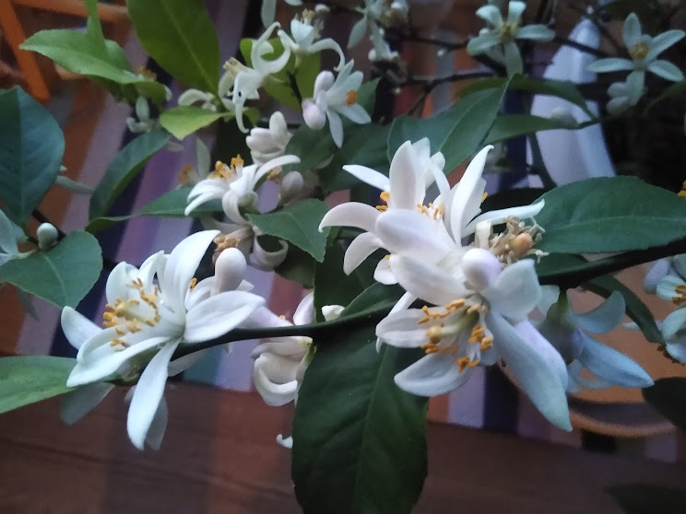
What we’ll cover:
Reasons to grow citrus
Select the right plant
Container and soil recommendations
Soil & Fertilizing
Watering
Pruning
Lighting requirements
Inside and outside times of the year
Problems

Slide 3
Reasons to Grow Citrus
Can be grown indoors and outdoors
Relatively easy to grow in our climate
Great to eat fresh or in cooking or baking
They are beautiful and smell good

Slide 4
Citrus go way back

Slide 5
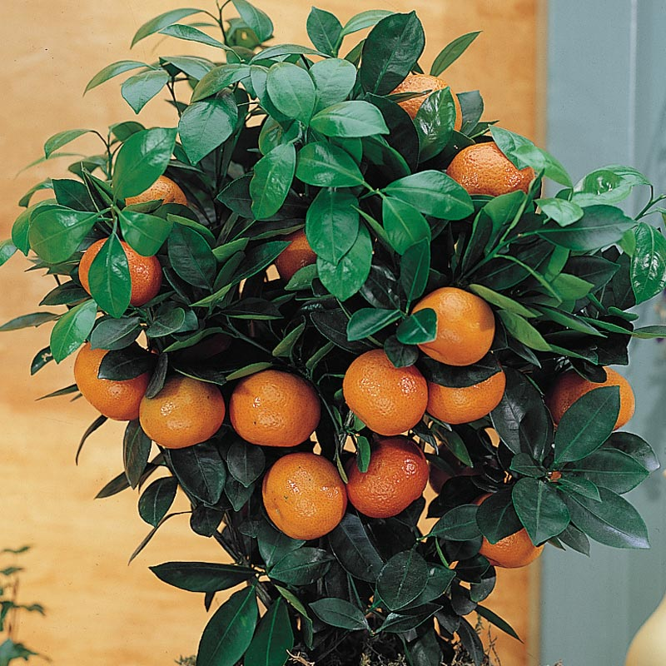
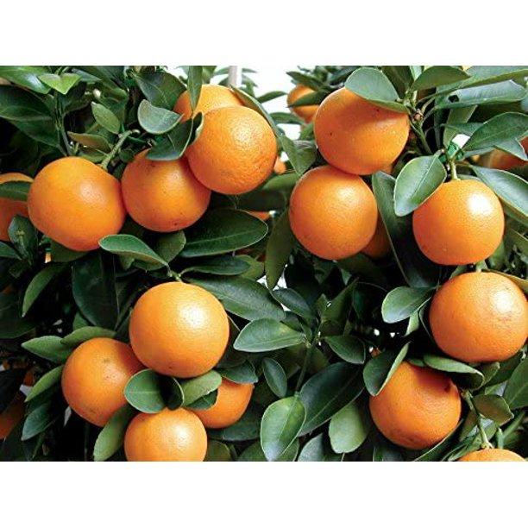
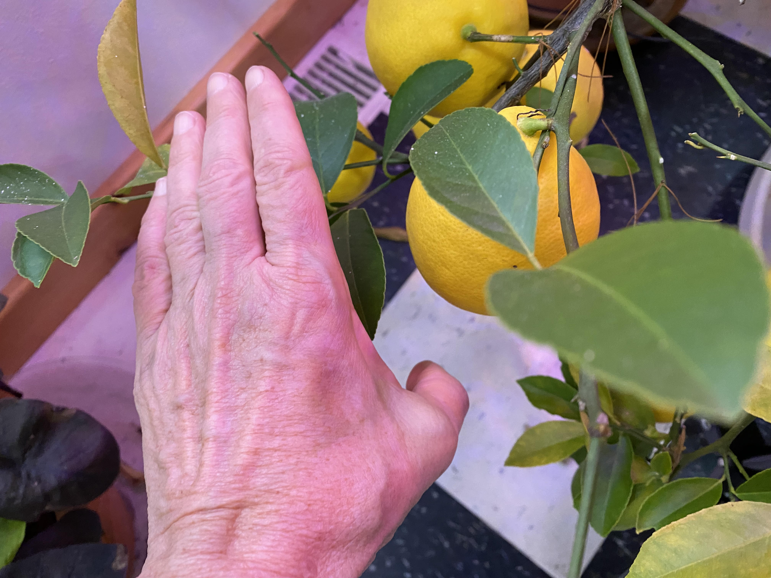
Choose the right dwarf plant
Dwarf varieties of:
Meyer Lemon
Calamondin Orange
Kumquats
Notes:
Here are three varieties that can produce fruit indoors as well.

Slide 6
Many dwarf varieties.
Notes:
Many varieties of citrus can be grown indoors

Slide 7
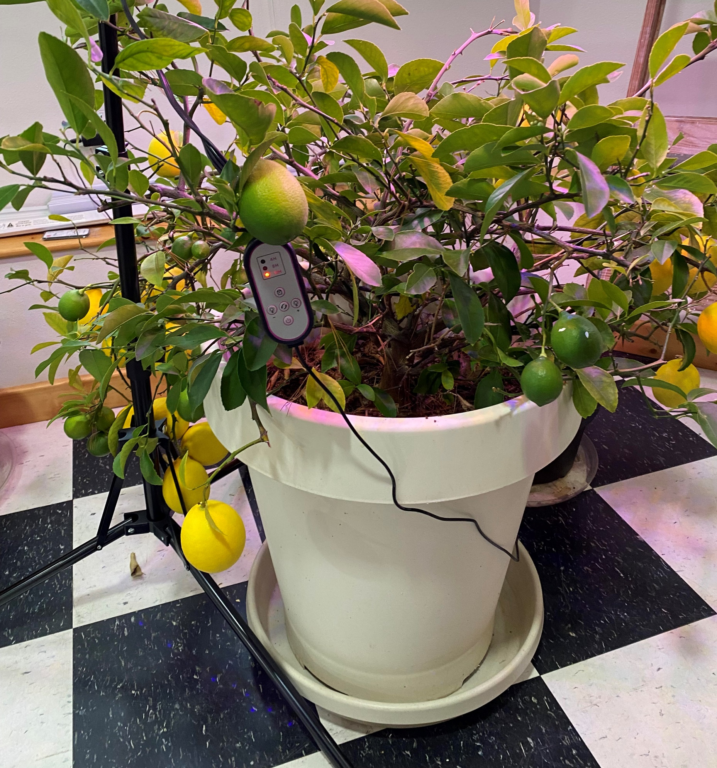
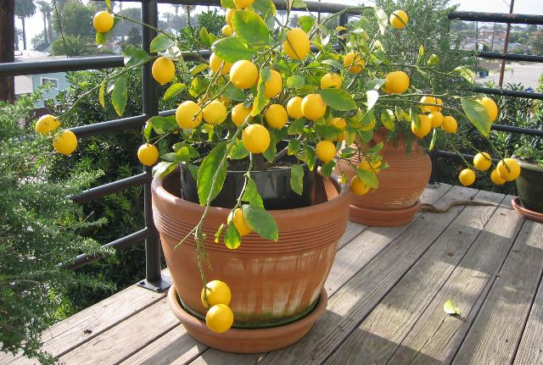
Choose the right container
Consider size and material
Notes:
You’ll want a pot that is deeper than it is wide. If you start out with a very small tree when you repot go about 4 inches larger. Sometimes if a pot is too large people can have trouble with it blooming.

Slide 8
Citrus Soil Needs
Well-draining, yet highly fertile soilless mix.
Don’t use garden soil
Repot every few years
Or if you want to make your own mix, you’ll want to do something like this:
5 parts pine bark fines;
1 part sphagnum peat OR coconut coir;
1-2 parts perlite;
1 part good compost.

Slide 9
Balanced pH important for citrus
Diagram from
www.yara.us/crop-nutrition/citrus/agronomic-principles/
Notes:
At lower pH values, trees can suffer from aluminum and other heavy metal ion toxicity as well as restricted P availability. At pH values above 7.5, nutrient availability, in particular of phosphorus and micronutrients, can be reduced, even though high total amounts of these elements may be present in the soil.

Slide 10
Citrus Fertilization
Citrus are heavy feeders.
Citrus fertilizer 6-3-3 (High in Nitrogen)
Fish Emulsion
Citrus fertilization schedule:
Spring – small amount of fertilizer once every 2-3 weeks.
Summer – fertilize once every 3-4 weeks.
Winter – fertilize once every 6 weeks.

Slide 11
Watering your citrus
Thoroughly water once or twice a week
Moist, not wet
No cold feet for citrus
50% humidity
Don’t let it sit in water
Don’t allow to dry out
Group plants
5.5 – 7 pH for water

Slide 12
Increase humidity
Group plants
Mist
Place pot on stones

Slide 13
Pruning citrus
Prune shoots that arise from below the graft
Prune for shape and balance in spring to get rid of leggy branches
Notes:
Citrus enjoys temperatures between 50 and 85 degrees Fahrenheit, with temperatures around 65 being ideal. During warm weather your citrus will do best outdoors. Avoid windy locations or anywhere your plant might be subject to standing water.
When the weather turns colder, bring your citrus plant inside. First, move it to a shaded area outdoors, then onto a porch, and then indoors. By gradually acclimating it to less sun, you reduce the chance of adverse effects from the change in conditions from outdoors to in. This same process should be followed in reverse when moving your plant from inside to out in summer to avoid sunburn damage to the foliage.
Your citrus plant needs plenty of bright light, around 8 to 12 hours daily of sunlight or sunlight supplemented with grow lights.
Thoroughly water your citrus plant once or twice a week when the first inch or so below the soil's surface feels dry. Citrus prefers moist, but not wet, soil. Never allow the pot to sit in water or dry out completely.

Slide 14
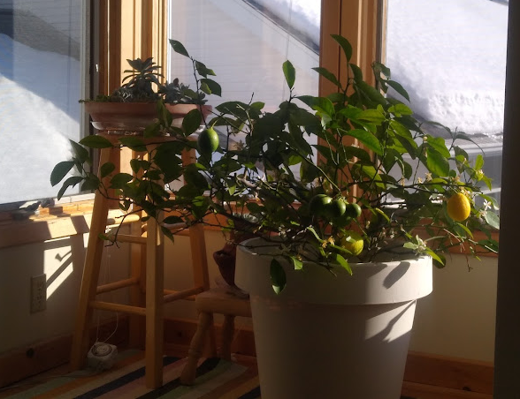
Lighting & temperature needs

Slide 15
Grow Lights for Indoor Plants, Led Grow Light with Stand Adjustable 15.7-63 inches Full Spectrum 6/9/12H Plant Light for Various Plants

Slide 16
Not enough sun? 8 – 12 hours light needed

Slide 17
Moving from inside to outside and reverse
To outside start in shadier area
Then transition to full sun
Temperatures best 50 – 85
When moving in first to a porch
Outdoors is where they are happiest

Slide 18
Moving large plants in and out of doors

Slide 19
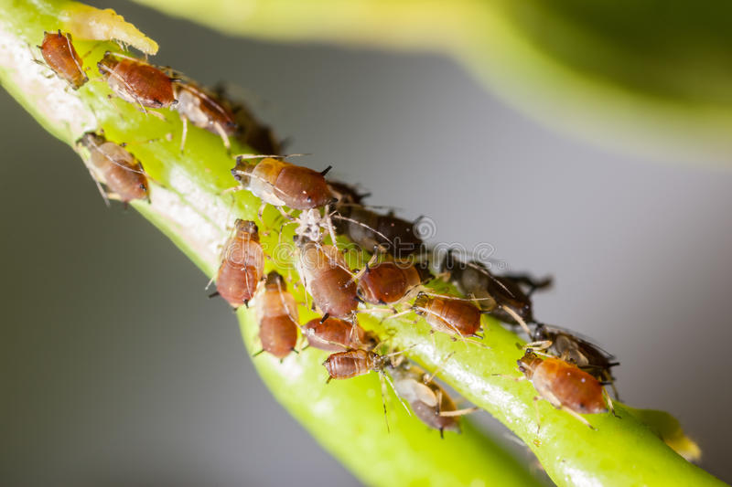
Problems growing citrus
No blossoms
Pot too large
Over fertilized
Blossoms – no fruit
Dry air
Needs help pollinating
Pests
Hand pick
Insecticidal soap
Dab mealbug with alcohol dipped swab
Firm spray with water hose
Notes:
During spring and summer feed your plant about once a month with a fertilizer that's high in nitrogen. Fertilizers specifically formulated for citrus trees are commercially available. Be sure to follow directions on the package.
Indoors, dry air can be a problem. To increase humidity, group other houseplants nearby. You also can fill a tray of small stones with water and place the pot on top of it, being careful the water doesn't reach the bottom of the pot. Ideally, you might consider investing in an ultrasonic humidifier that will help humidify the entire room.
Repot every few years. Choose a pot deeper than it is wide and that has several drainage holes. You'll want to use a light potting mix that will drain well. Avoid additives that retain moisture.
Although you can buy citrus potting mixes, any well-drained commercial potting pot mix can be satisfactory. Be sure the graft union (where the citrus plant is joined to the dwarfing rootstock) is above the soil line when repotting. Water the potting mix thoroughly after repotting.
Container-grown citrus is likely to bloom in spring, though buds can appear year-round, even when fruit is already ripening on the plant. You won't need another citrus plant to cross pollinate to produce fruit, but you will need to give the flowers a little assistance. You can gently shake the plant to encourage pollination. Using a cotton swab to pollinate the flowers also works well.
Soon after, tiny, green fruit should appear. Don't be discouraged if some drop. There may have been more flowers pollinated than the plant can support, or it may be stressed due to moving from one location to another or too much or too little water.
Fruit typically matures in 6 to 9 months although some, such as oranges, take up to a year. Once the fruit has ripened, it can remain on the citrus plant for some time before picking.

Slide 20
Not developing fruit? Spray for humidity, pollinate with brush.

Slide 21
Lemons in many stages at once
Blossoms, newly forming fruit, green and ripe can be on tree all at once
Lemons, once ripe hold on the tree for weeks, months

Slide 22
Sources for Citrus
Klingers Farm Market has lemon
Chippewa Valley Growers
Online there are many option

Slide 23
Wisconsin’s Only Citrus Nursery- Sun Prairie https://franksfruittrees.com/

Slide 24
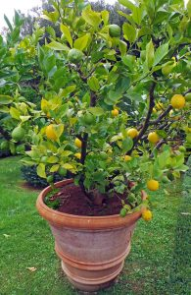
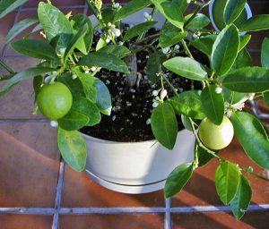
Wisconsin Resource on Citrus
https://hort.extension.wisc.edu/articles/indoor-citrus/

Slide 25
Why I grow lemons…..
Greek Lemon Potatoes,
Chicken Breast with Lemon
Over asparagus and seafood
Lemon cookies

Slide 26
Questions?
Thank you
Ellen Terwilliger
Master Gardener Volunteer – Eau Claire, WI
terwilset@gmail.com

